Slide 1

INTRODUCTION TO GNH
TIME USE
GROUP 3

Slide 2
TIME USE AND HAPPINESS
Time use is very important but limited resource that is available to us
Time use surveys are carried out by various organisations in every country to determine how useful information missing in conventional economic account
Time use percentage helps us to determine mental as well as physical health of an individual
Our objective is to observe the work-life balance of the students in IIT Kharagpur and how the pandemic has affected their time management ,usage and their work life balance.

Slide 3
Methodology in India
To tackle the question of time use, we searched for previous studies upon this topic. We found 2 studies that captured our interest.
One was a time use survey conducted by the Indian Government taking into consideration time use in various activities, personal care, etc. But it took into account, people from all walks of life.
Second was a survey showing how US college students spent their time. However, there would be some differences for Indian students.
But we can’t take either of them to predict how students of IIT Kharagpur use their time, so we had to create new indicators for our study.

Slide 4
INDICATORS
Studying and related activities Sleep Social interaction Mental Health Physical Health Social Media Eating Extracurricular activities
Based on our interpretations from the above 2 studies ,to get a more specific view of how students of IIT KGP spend their time ,we came up with the following indicators that best depict how students spent their time and how the pandemic has affected it.

Slide 5
METHODOLOGY
Taking into consideration the indicators mentioned before and the loopholes in our previous method we decided to conduct a survey focused towards IIT Kharagpur students to get accurate results for the time use questions in order to see how the pandemic has affected their time usage and work life balance

Slide 6





Results
&
Conclusions

Slide 7
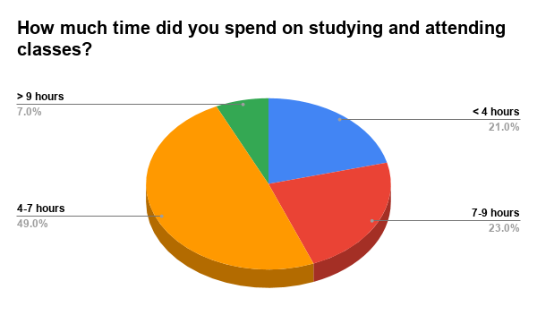
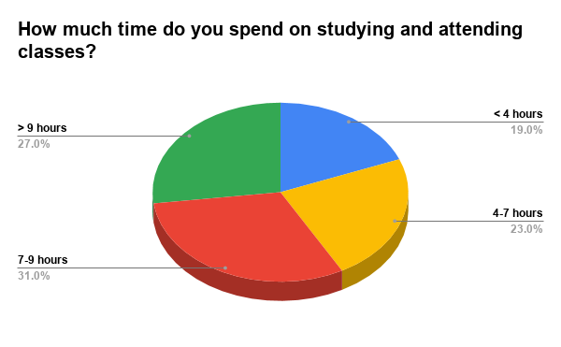
Before Pandemic
During Pandemic
We see that approximately 46% of students either study more than 9 hours or less than 4 hours.
We can see that there is massive increase in total study hours for students during this pandemic because of the tight schedule. Also 58% of students study for at least 7 hours.

Slide 8
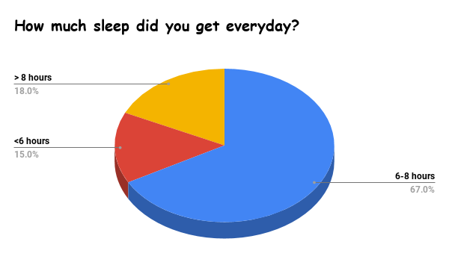
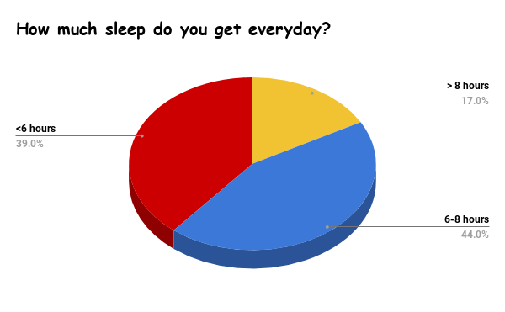
Before Pandemic
During Pandemic
We see that there is a drastic increase of number students (around 24% of them) who get less than 6 hours of sleep, which is both harmful to productivity and general well-being.

Slide 9
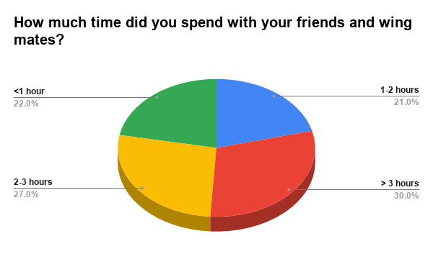
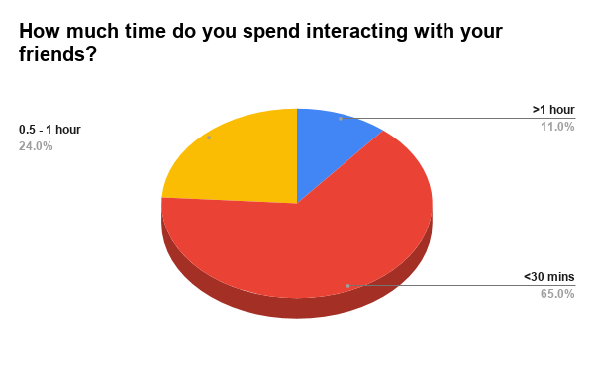
Before Pandemic
During Pandemic
During Pandemic we see that the amount of time spend interacting with the friends have decreased ,as most of the students are not in college. Hence the social interaction with friends is very low.

Slide 10
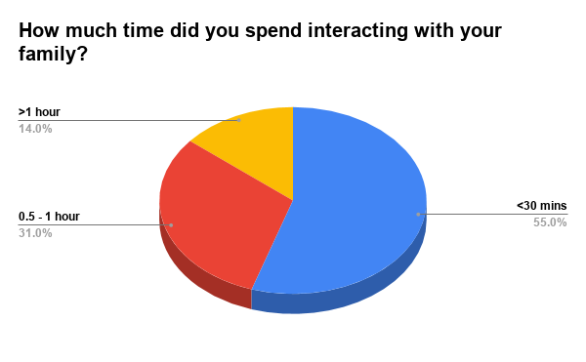
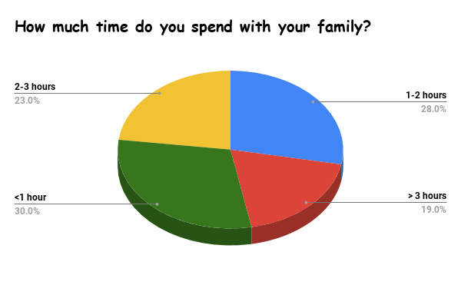
Before Pandemic
During Pandemic
We see that there is an increase in amount of time spent with family, as most of the students stay home. This tells us that students get time to discuss their day and can show affection towards their family.

Slide 11
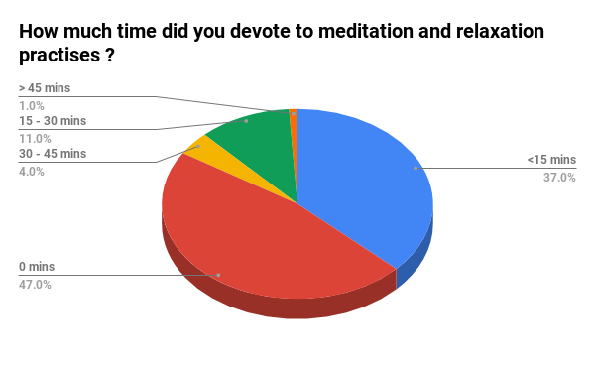
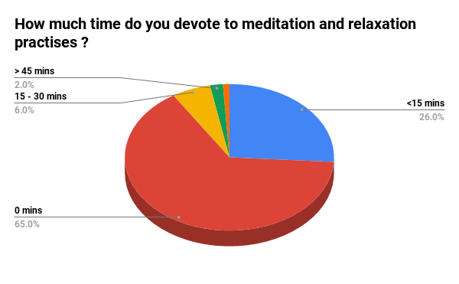
Before Pandemic
During Pandemic
We see that 65% of students don’t even spend a second on meditation and relaxation practises. This is highly concerning as meditation helps one relax and be calm in tense situations and navigate successfully through the emotionally charged and taxing years of college life.

Slide 12
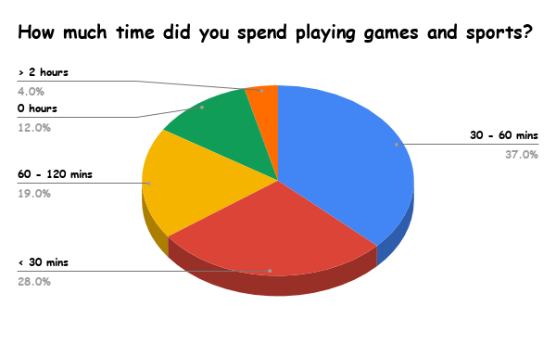
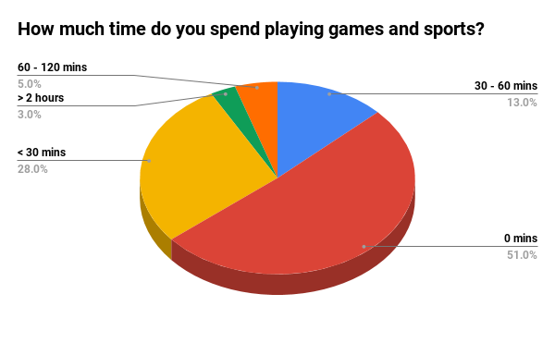
Before Pandemic
During Pandemic
We see that the amount of time spent on games and sports decreased by a great margin. During pandemic, more than 50% of the students don’t even play because, most of the sports are played as group and it isn't safe like before, to get into groups. This has a negative impact on the physical health of students as most of the physical exercise comes from playing sports.

Slide 13
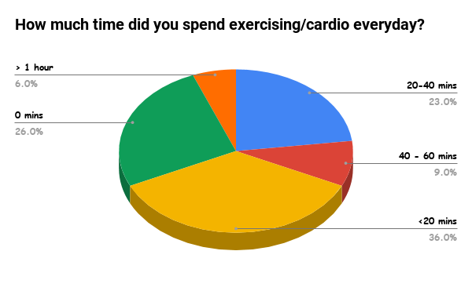
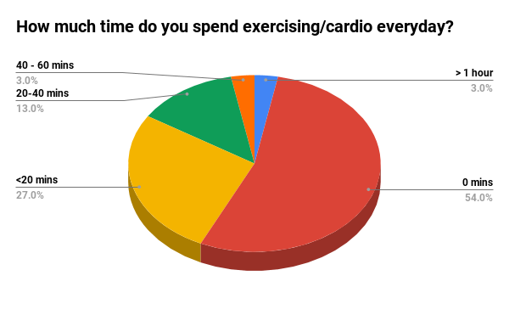
Before Pandemic
During Pandemic
The number of students spending time on cardio and exercises have decreased drastically due to the lockdown procedures and protocols . It is very concerning that their physical health is being affected badly.

Slide 14
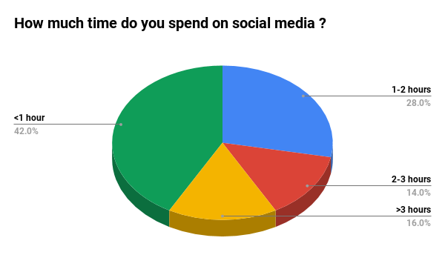
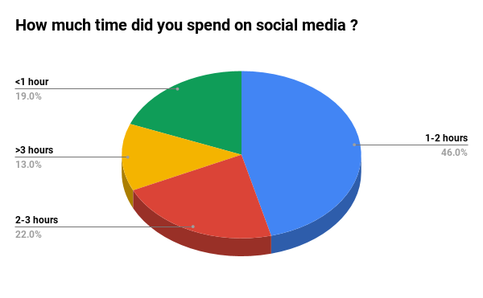
Before Pandemic
During Pandemic
We see that there is increase in number of students (33% of students increased) students are addicted to social media ,they continue to surf and resist other activities.

Slide 15
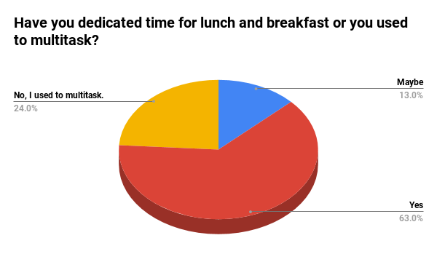
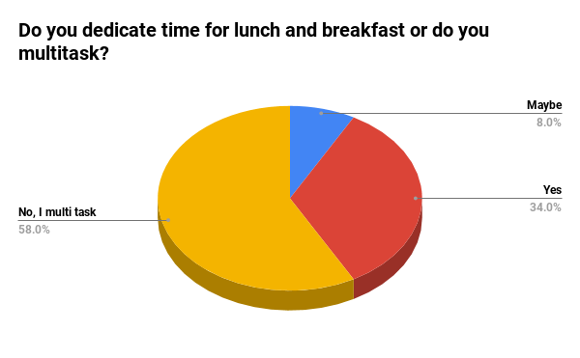
Before Pandemic
During Pandemic
We can see that majority of the students switched to multi-tasking the food intake. It is very concerning to see that students are not even eating in peace because of their increased study and work time.

Slide 16
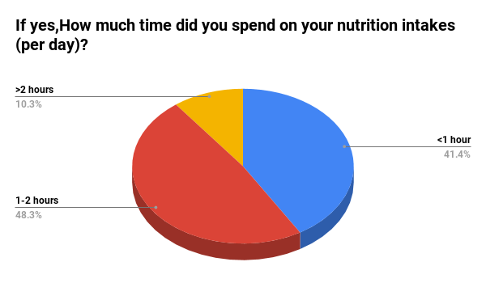
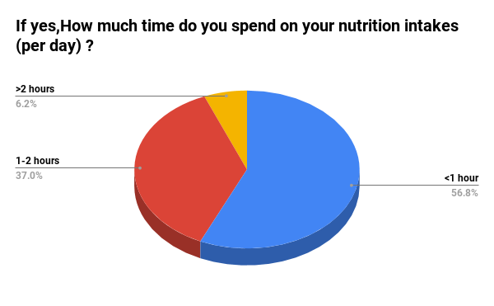
Before Pandemic
During Pandemic
We can see that many students have reduced their food intake time , they are rushing to eat food rather eating peacefully. It is concerning because they are either consuming less food than required or gulping the food in order to have more time to study and work. Both are not good for one's health , especially malnutrition.

Slide 17
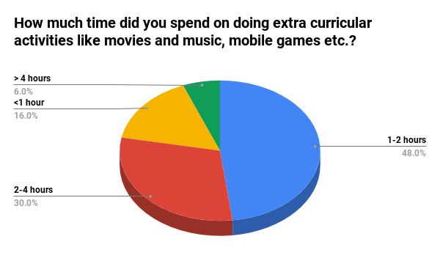
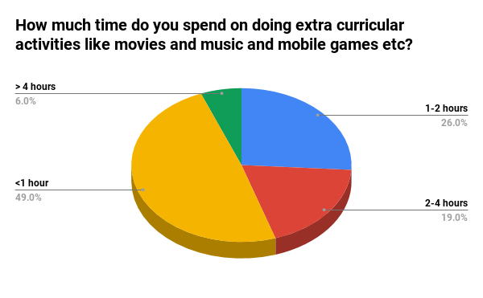
Before Pandemic
During Pandemic
We see that there is a decrease in the number of students(84% of students before pandemic and 51% of students after pandemic)who spend their time in extracurricular activities. Which clearly indicates the increased workload, and students don’t have sufficient leisure time.

Slide 18
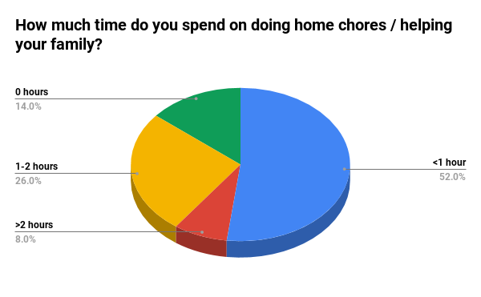
It is good to see students taking some time to help their family. They couldn't do that before because everyone were in college.

Slide 19
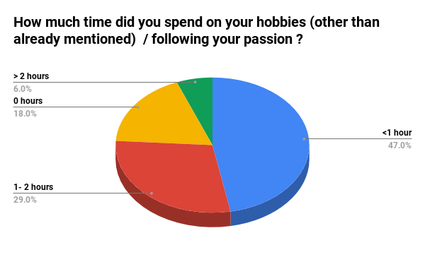
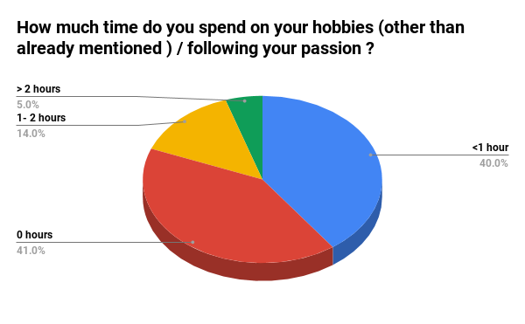
Before Pandemic
During Pandemic
We see that there is an increase in the number of students(23%)who do not spend their time on their hobbies. Which indicates the increased workload and students don’t even have sufficient time to follow their passion.

Slide 20
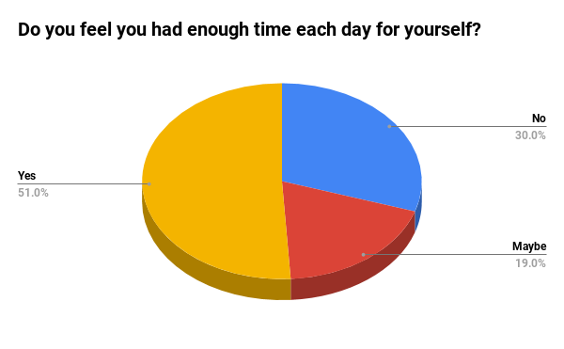
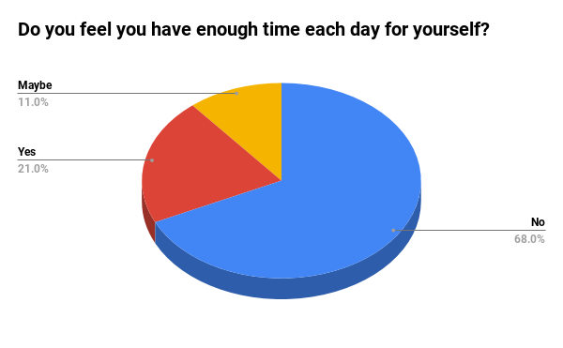
Before Pandemic
During Pandemic
We can see there is a large margin shift towards "NO" during pandemic. It is concerning as so many students are putting all their efforts on work and are not able to focus on the other activities which is making them feel like they don’t have sufficient time.

Slide 21
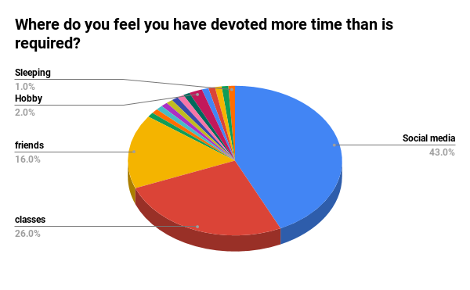
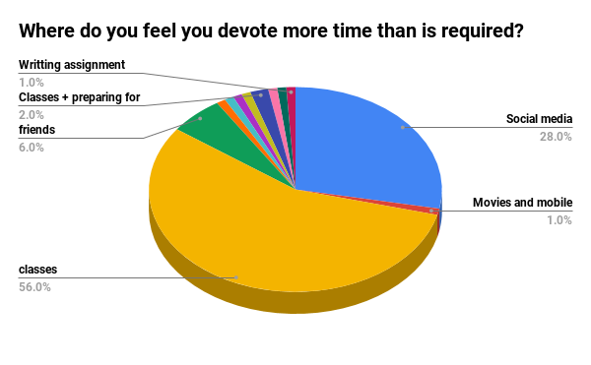
Before Pandemic
During Pandemic
We can see that in both the cases, Social media is one of the major factor where students think they spend more time than required. People are spending more time even though they are acknowledging that it is excess. This is the effect social media has on people. During the pandemic, more than half of the students feel classes are consuming excess time than required .

Slide 22
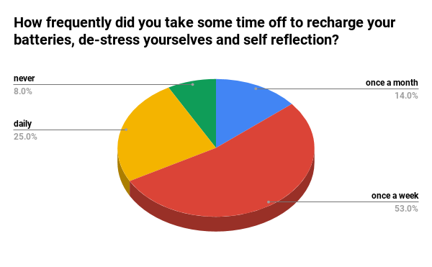
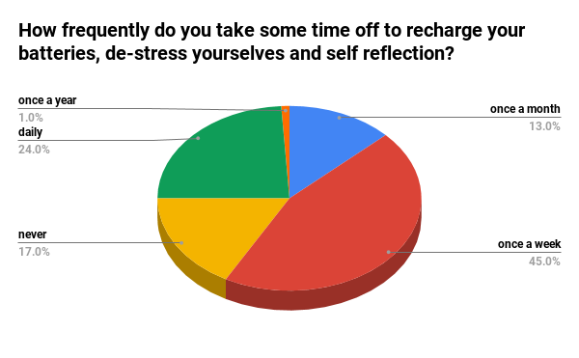
Before Pandemic
During Pandemic
It is observed that students don't have enough time or not taking some time off to reflect upon themselves. It is good that 82 % of students take some time off but there has been an increase of 9% of students, who, now do not reflect on themselves.

Slide 23
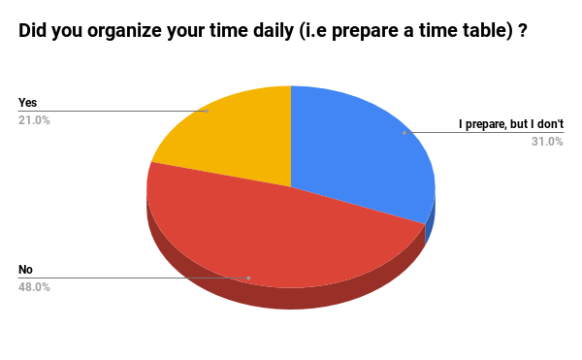
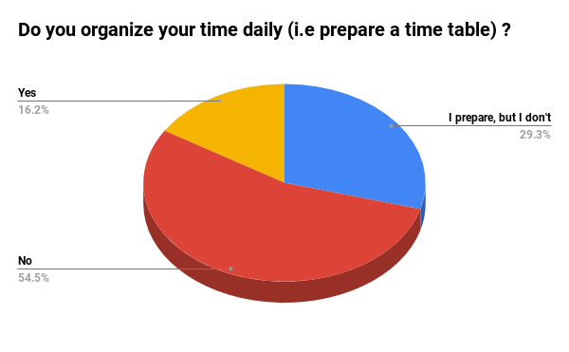
Before Pandemic
During Pandemic
We can see that there isn't much effect on students whether they prepare a schedule or not because of the pandemic.

Slide 24
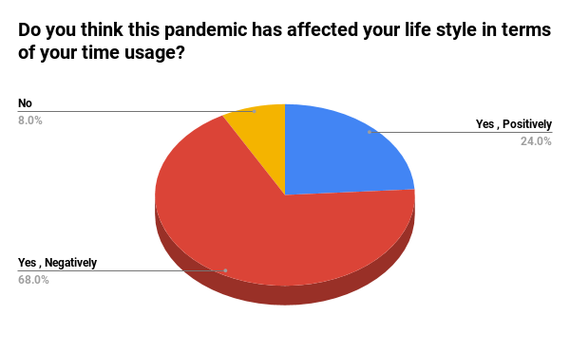
Many people feel that this pandemic has affected them negatively and rightly so. Some students feel that this pandemic has affected them positively, might be because they are able to spend time with their family.

Slide 25
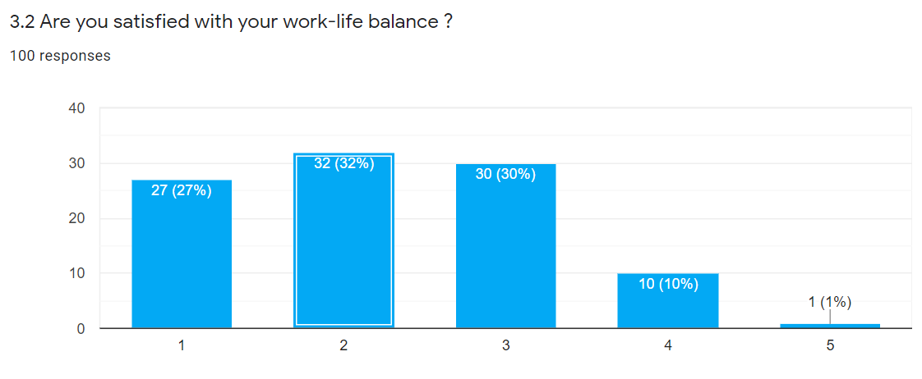

Slide 26
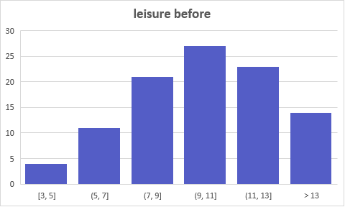
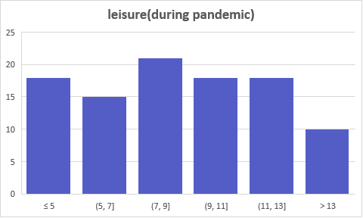
The histograms below indicate the time spent (in hours) by students apart from sleep and work. We can see that 21% of students have spent roughly the ideal time of 8 hours but a huge population of students( 64 %) have spent at least 9 hours. During the pandemic the number of students following the ideal time haven't changed but number of students who have spent more than 9 hours dropped down to 46%.

Slide 27
Work-Life Balance
We have estimated the work life balance by approximating the ranges to its mid value and summing up all the time into their respective categories sleep or work or leisure. The ideal time for work life balance is 8 hours each, so we have calculated the error in each category and summed the up to get the total error of one's work life balance.

Slide 28
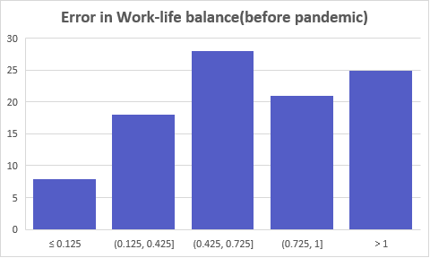
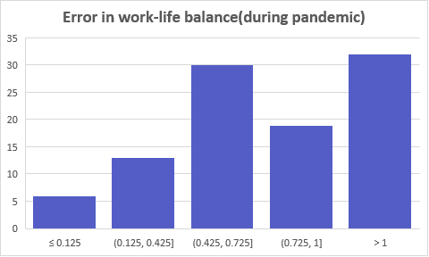
We can see that only 6% of people are closer to having work-life balance and 74% of students are way off. There is a decrease in number of students who are close to the work-life balance ( 26% initially to 19% )

Slide 29
Conclusion
Upon the analysis of the data obtained from the survey , we found that majority of the students fail at least 4 out of 8 indicators.
Many students devote more time to social media and considerable number of students devote more time for their study ,because of the revised short schedule , instead they need to devote time for their physical and mental health
We observed that very few students have work-life balance, and many people are far off. And the pandemic worsened the balance of students who were having decent work-life balance.
Majority of students need to reduce the usage of their time in leisure and invest in their study and sleep categories.
We have observed that people who are closer to work-life balance are not much affected by pandemic or rather they adapted to it very quickly

Slide 30
References
Report of the Time Use Survey , conducted by central Statistical Organization ,Ministry of Statistics and Program Implementation , Government of India.
American Time Use Survey , conducted by US Census Bureau
Link to the form
Link to responses

Slide 31
Thank you
Group – 3
V Yashwanth Babu 18EC10069
A Harsha Vardhan 18EC10021
N Siva Krishna Sai 18EC10037
K P S Prasanth 18EC30030
Ch Chinni Krishna 18EC10010
Rajat Subhra Roy 18EC10044

